Slide 1
Object Oriented Methodology Lab
Md. Mujahid Islam
Software Developer & Guest Lecturer

Slide 2
Control Statement
Java’s program control statements can be put into the following categories: selection, iteration, and jump. Selection statements allow your program to choose different paths of execution based upon the outcome of an expression or the state of a variable. Iteration statements enable program execution to repeat one or more statements (that is, iteration statements form loops). Jump statements allow your program to execute in a nonlinear fashion. All of Java’s control statements are examined here.
Java supports two selection statements: if and switch.

Slide 3
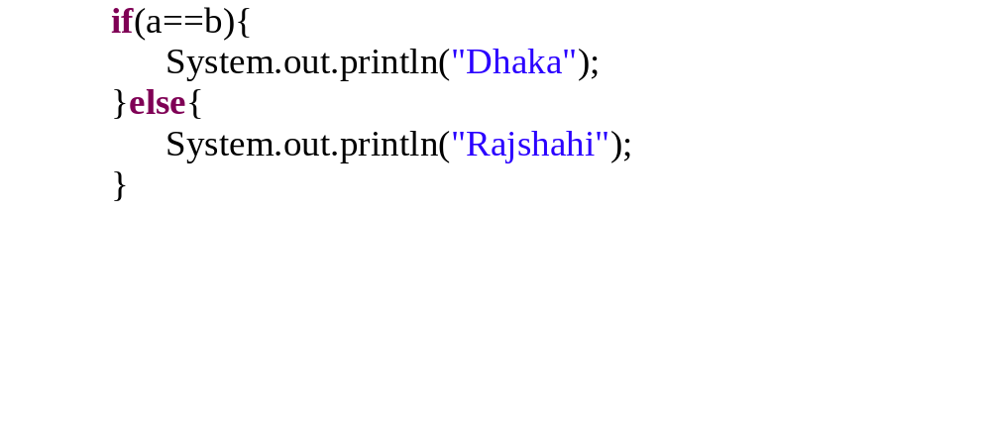
If Selection
if (condition) statement1;
else statement2;
Example :

Slide 4
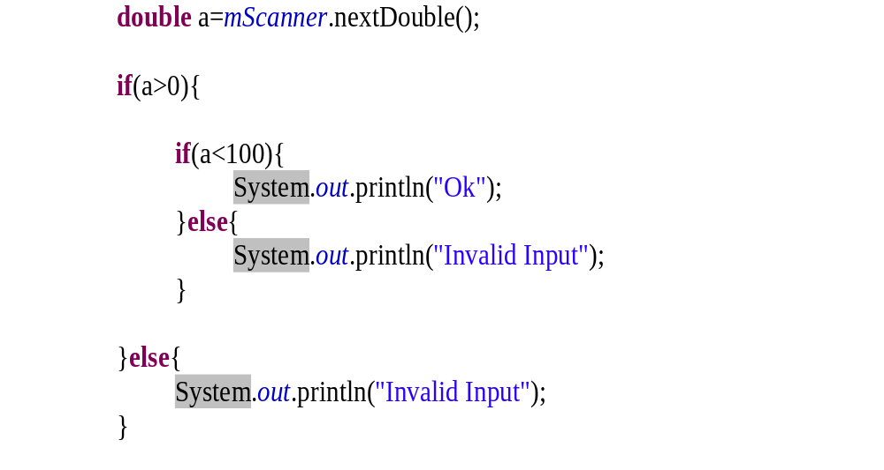
Nested ifs
if (condition) {
  if (condition) statement1;
    if (condition) statement1;
    else statement2;
  }
else statement2;

Slide 5
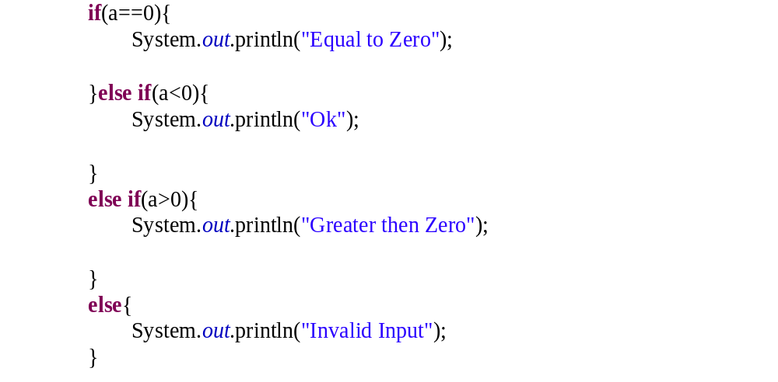
The if-else-if Ladder
if(condition) statement;
else if(condition) statement;
else if(condition) statement;
.
.
.
else statement;

Slide 6
Switch
The switch statement is Java’s multiway branch statement. It provides an easy way to dispatch execution to different parts of your code based on the value of an expression.
For versions of Java prior to JDK 7, expression must be of type byte, short, int, char, or an enumeration. Beginning with JDK 7, expression can also be of type String.
Each value specified in the case statements must be a unique constant expression. Duplicate case values are not allowed.
The type of each value must be compatible with the type of expression.
The break statement is optional. If you omit the break, execution will continue on into the next case.

Slide 7
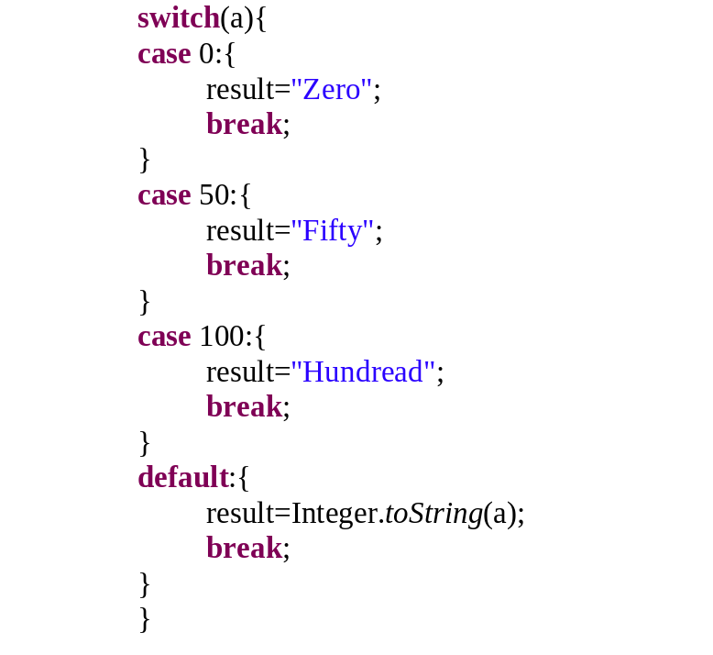
Switch Statement
switch (expression) {
case value1: // statement sequence
break;
case value2: // statement sequence
break;
.
.
.
default:
// default statement sequence
}

Slide 8
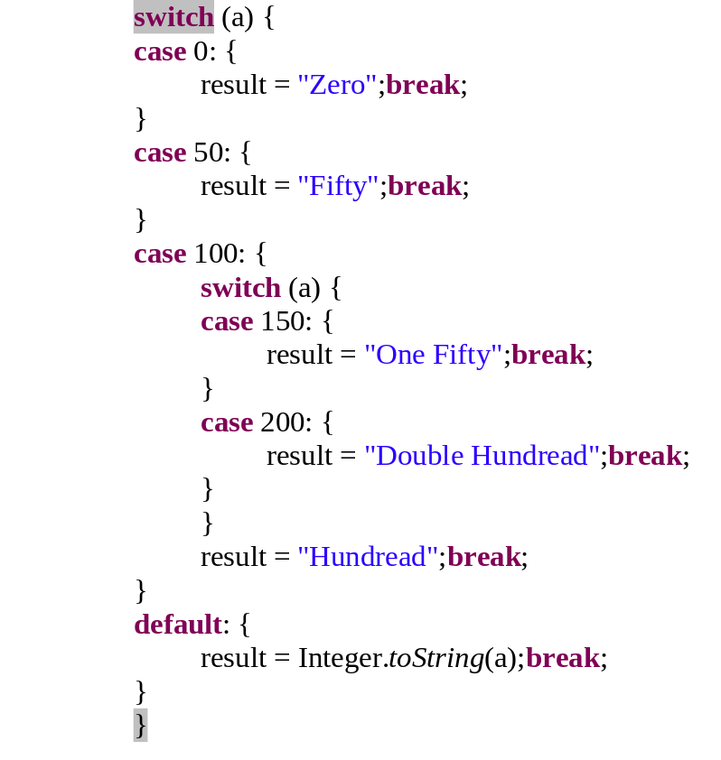
Switch Statement
switch(count) {
case 1:
switch(target) { // nested switch
case 0:
System.out.println("target is zero");
break;
case 1: // no conflicts with outer switch
System.out.println("target is one");
break;
}
break;
case 2: // ...

Slide 9
  Source Code
  Variable Naming convention

Slide 10
  Questions?

